Slide 1
Retail and Wholesale Business

Slide 2
Agenda

Slide 3
Economic Overview

Slide 4
Industry Overview

Slide 5
Company

Slide 6
Walmart
Analyst Opinion
Management
Positioning & strategy
Red flags (payoff and legal issues)
Ratio & trend analysis
DCF Analysis
Scenario Analysis (COGS & membership)*
Comps Valuation
Risk & contingencies

Slide 7
Analyst Opinion

Slide 8
Management

Slide 9
Positioning & Strategy
Competitive Positioning: North America’s biggest Retailer and Wholesaler (Market Cap: $409 bn)
Mission Statement: “Save people money so they can live better”
Target Market: budget-conscious consumers in suburban and rural areas
Wide range of products and merchandises available in stores and through eCommerce
EDLP (Every Day Low Prices):
Focus on low prices through cost-cutting and economies of scale
Significant investment in eCommerce, including online selection and services like grocery pickup and delivery

Slide 10
Red Flags

Slide 11
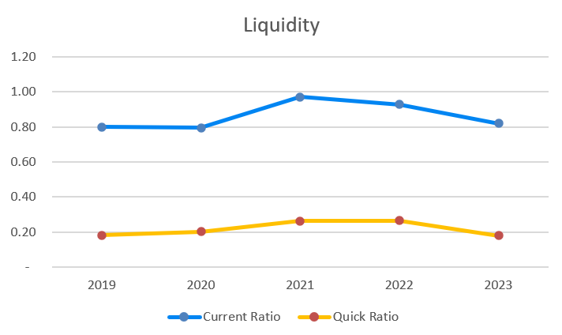
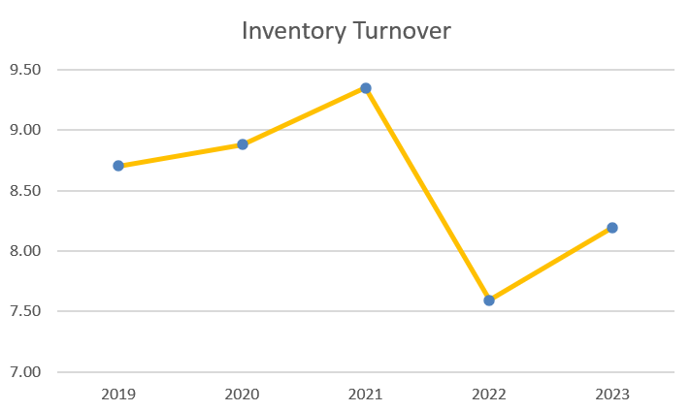
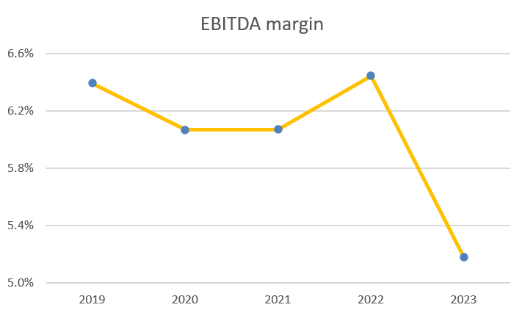
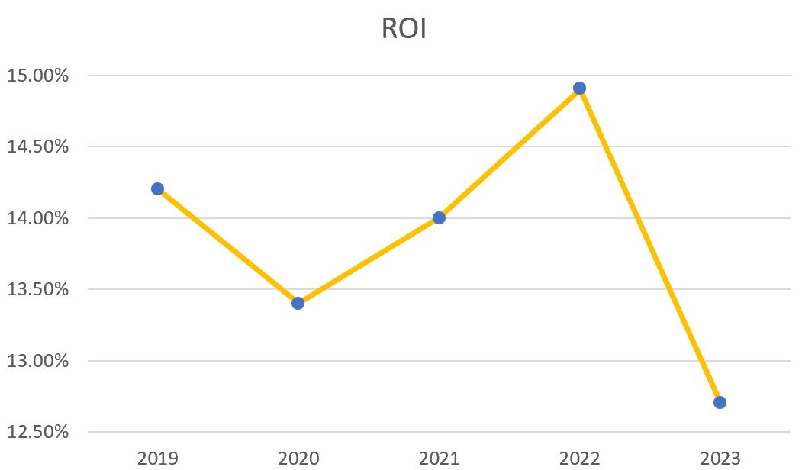
Ratio and Trend Analysis

Slide 12
DCF Analysis
Key assumptions
Sensitivity analysis
Bear/bull/base case overall

Slide 13
Scenario Analysis
COGS
Membership

